Slide 1
Whole Code Explanation
IoT attack detection explained like a story for class 4-5 students
📱 🧠 🔒 📡 🚨
Important: The paper is a review paper. It does not give one full runnable program. So this deck turns the paper ideas into simple "story-code" and explains every line.
Source: Ieropoulos et al., Journal of Information Security and Applications, 2025

Slide 2
Before Code: What are we building?
A tiny guard system for small IoT devices like cameras, locks, bulbs, and sensors.
1
Device watches itself
2
It learns
3
It warns
It looks at its own small data, like traffic or messages.
It learns what is normal and what looks strange.
If something looks like an attack, it sends an alert.
📱
🧠
🚨
Paper basis: collaborative learning helps IoT devices share knowledge while reducing individual device load.

Slide 3
Story-code Part 1: Wake up and collect data
Think of each IoT device as a little student collecting clues.
Story-code
What it means
01
START IoT_Guard
Start the small security guard.
02
devices = find_IoT_devices()
Find cameras, locks, bulbs, sensors.
03
for each device:
Do the same work for every device.
04
data = read_local_data()
Read only that device's own data.
05
keep_data_private(data)
Do not send private raw data outside.
06
normal = learn_normal(data)
Learn normal behaviour first.
07
strange = compare(data, normal)
Check if today looks different.
08
save_small_result(strange)
Keep a small result, not all data.
Main idea: each device learns from its own data first.
Paper basis: Federated Learning trains on local IoT data without centralising sensitive raw data.

Slide 4
Story-code Part 2: Share only a small learning update
The device does not give away its diary; it sends only a tiny lesson.
Story-code
What it means
09
update = make_model_update()
Make a small learning message.
10
update = lock(update)
Protect it with security.
11
if central_server_exists:
If there is a big helper computer.
12
send(update, server)
Send the tiny lesson to that helper.
13
else:
If there is no big helper.
14
send(update, neighbours)
Send it to nearby trusted devices.
15
wait_for_other_updates()
Wait for lessons from friends.
16
drop_bad_or_late_updates()
Ignore bad, missing, or too-late lessons.
Paper basis: FL shares model updates/aggregated results, not raw sensitive data.

Slide 5
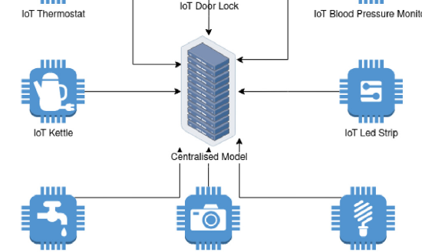
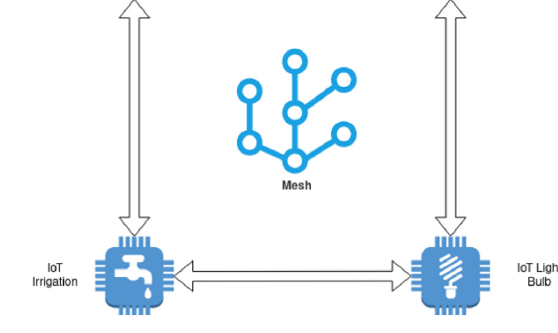
Lines 11-14: Two ways the sharing can happen
The paper explains centralised and decentralised federated learning.
Centralised: all devices send updates to one helper server.
Decentralised: devices talk to other devices, like friends in a circle.
Code line: send(update, server)
Code line: send(update, neighbours)
Images cropped from the paper: Fig. 2 and Fig. 3.

Slide 6
Story-code Part 3: Mix the lessons together
This is like many students making one better class answer.
Story-code
What it means
17
group = collect_updates()
Collect small lessons from devices.
18
safe_group = check_trust(group)
Check who is safe to trust.
19
global_model = average(safe_group)
Mix good lessons into one brain.
20
if device_is_weak:
If a device is small or low-power.
21
send_smaller_model()
Send it a lighter version.
22
else:
If the device can handle more work.
23
send_full_model()
Send the normal model.
24
repeat_next_round()
Do it again later to keep learning.
Important word: "average" means combine many learning messages into one better model.
Paper basis: FedAvg and other aggregation methods combine local model updates.

Slide 7
Story-code Part 4: Check for attacks
An attack is bad behaviour that can stop devices or steal/change data.
Story-code
What it means
25
traffic = watch_network()
Look at messages going in and out.
26
score = global_model(traffic)
Ask the model: normal or strange?
27
if score > danger_level:
If it looks very strange.
28
label = "attack"
Mark it as possible attack.
29
alert_owner(label)
Tell the owner/administrator.
30
else:
If everything looks normal.
31
label = "normal"
Mark it as safe.
32
keep_watching()
Continue checking again and again.
Possible attacks in the paper: DoS, jamming, botnet, adversarial input.
Paper basis: IoT devices face DoS, jamming, botnet, and adversarial attacks.

Slide 8
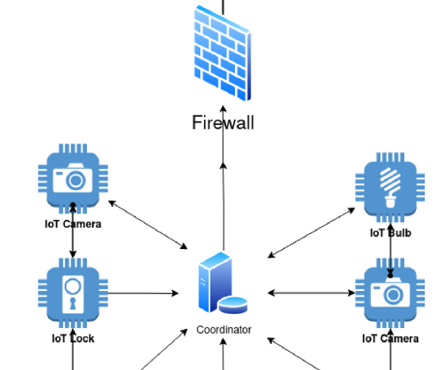
Story-code Part 5: Work with different devices
Some devices are strong, some are weak. The code must be kind to all of them.
33
if device.battery_low:
If battery is low.
34
do_less_work()
Do smaller work to save power.
35
if device.memory_small:
If memory is small.
36
use_tiny_model()
Use a tiny model.
37
if network_slow:
If internet is slow.
38
send_less_often()
Send fewer updates.
39
protect_with_auth()
Check the sender is real.
40
protect_with_encryption()
Hide the message from strangers.
Heterogeneous = not all devices are the same.
Image cropped from the paper: Fig. 4. Paper basis: devices have different hardware/software and need authentication/encryption.

Slide 9
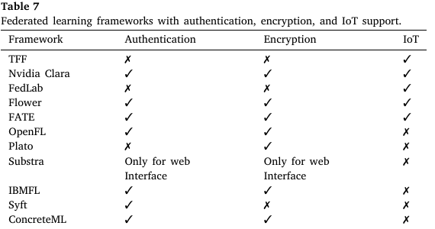
Security check: Which tools are safer?
The paper compares federated learning frameworks by security features.
1
Authentication
Like asking: “Are you really my friend?”
2
Encryption
Like putting the message inside a locked box.
3
IoT Support
Can it work with small smart devices?
The table checks 3 simple things:
✅ login check ✅ secret messages ✅ IoT support
For class 4: these are safety locks for the learning messages.
Table cropped from the paper: Table 7.

Slide 10
Whole code in one simple picture
From start to end, this is what the code is doing.
📱
Lines 1-4
🔒
Lines 5-8
📡
Lines 9-16
Find devices
Keep data private and learn normal
Share only small learning updates
🧠
Lines 17-24
🚨
Lines 25-32
🛡️
Lines 33-40
Mix updates into one better model
Watch traffic and detect attack
Adjust for weak devices and protect messages
Tiny meaning: Many IoT devices learn together to catch attacks, but they try not to share private raw data.
Paper basis: collaborative IDS, federated learning, centralised/decentralised/heterogeneous learning, and security features.

